Slide 1
Initial Problems of Pakistan
Administrative Problems
.Lack of officers and staff
.Infrastructure
SETTLEMENT OF REFUGEES
.ever largest Migration on earth.12.5 Million People Migrated.
.Killings
.Transportation
.Kidnappings

Slide 2
Division of Assets
To be given 1/4th
Capital of Federal Reserve Bank of India 4000 M
Gave only 500 M in the beginning
Refused to pay rest.
17.5 % of loans on India Adjusted in the amount
Agreed to pay rest but gave only 200 M
Helped out by Different States and Habib Bank

Slide 3
Military Assets
Division on 64% & 36 %
Commission Formed Headed by Field Martial Clyde Ocanlic
Few Tanks were given
Rusted ammunition
90 spitfire aircrafts at maripur base ,were sent to calcutta. Rest engines barred with sand
Agreed to pay money to establish 2 ammunition factories. Money never given

Slide 4
Canal water Dispute
Stopped water in 1948
Talks held
Indus Water Treaty 1960
(water accord 1888 Barcelona)
Water flows from India

Slide 5
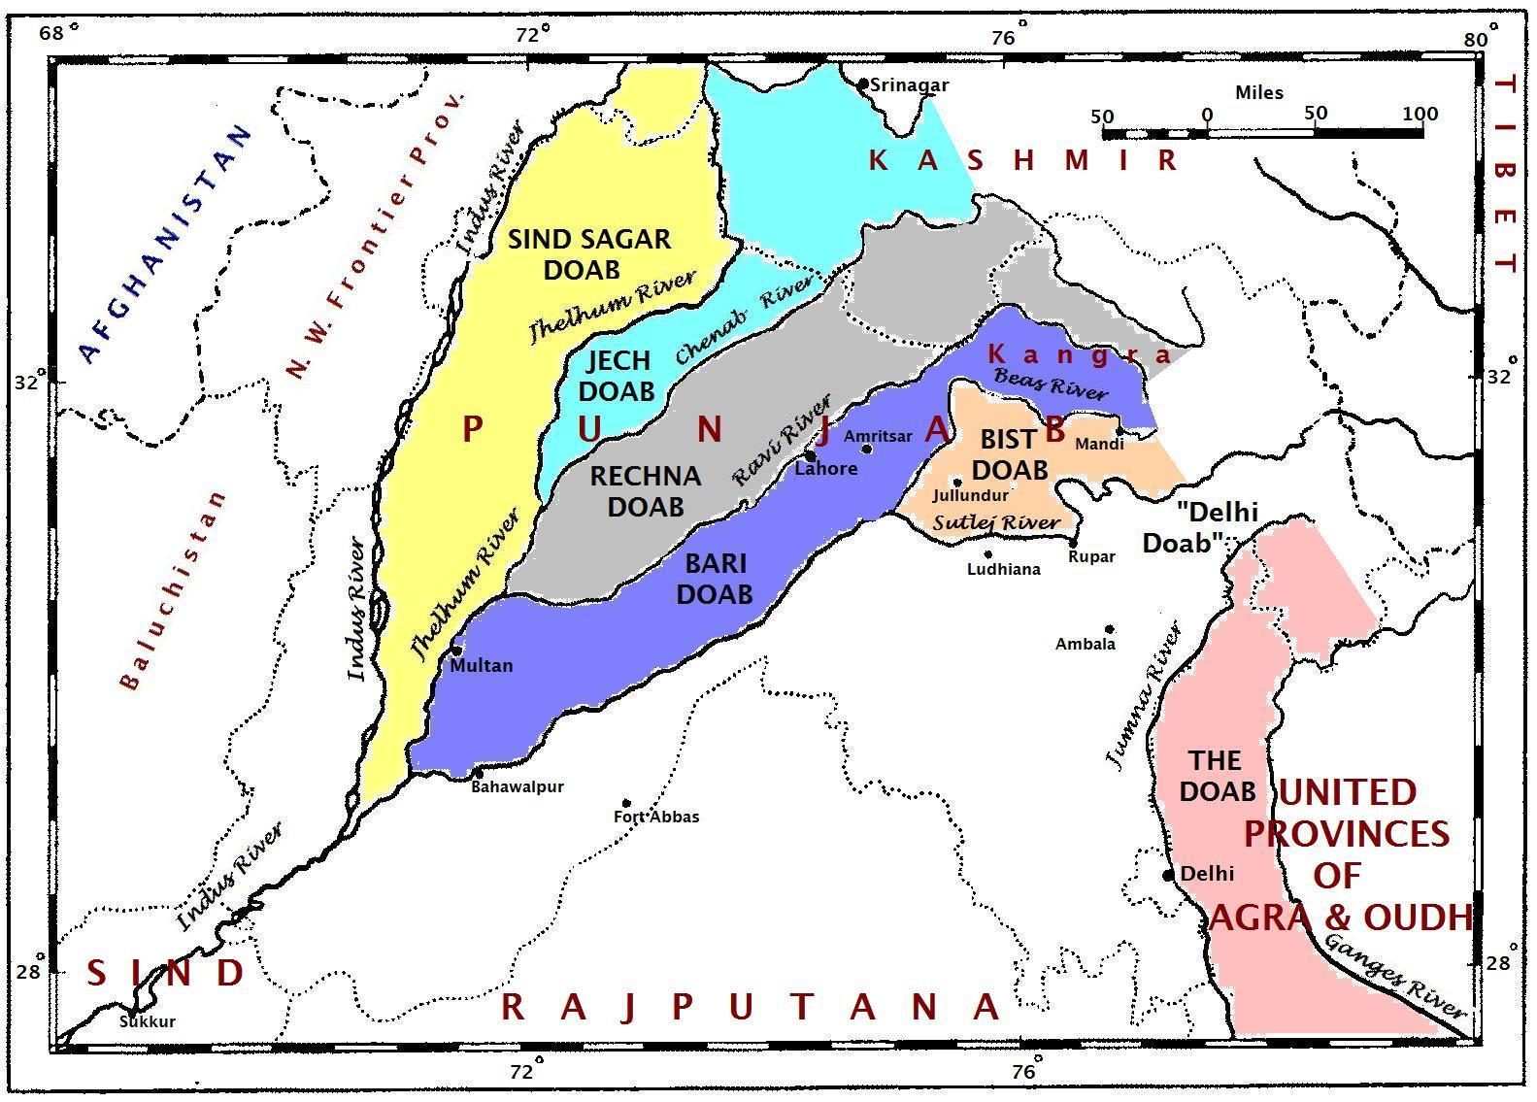

Slide 6
Accession of States
Juna Garh
Hyderabad Dakkan
Manawader
Kashmir- flash point
1846 Anglo Sikh war Kashmir was sold against 77 lak Nanak Shahi to Gulabd Singh
1947 Maharaja Hari Singh fled to India
Indians Invaded

Slide 7
Boundary Demarkation
2 commission were formed
Eastern&western Border
Rail link to kashmir through gurdaspur
Ferozpur given to India ( Ferozpur head works)
Madhu pur head works at Ravi
Calcutta given to India on eastern border

